Slide 1
Senate Veterans’ Affairs Committee 117th Congress
Democrats
Republicans
Sen. Jon Tester (D-MT) Chairman
Sen. Patty Murray (D-WA)
Sen. Bernie Sanders (I-VT)
Sen. Sherrod Brown (D-OH)
Sen. Richard Blumenthal (D-CT)
Sen. Mazie K. Hirono (D-HI)
Sen. Joe Manchin III. (D-WV)
Sen. Kyrsten Sinema (D-AZ)
Sen. Maggie Hassan (D-NH)
Sen. Jerry Moran (R-KS) Ranking Member
Sen. John Boozman (R-AR)
Sen. Bill Cassidy (R-LA)
Sen. Mike Rounds (R-SD)
Sen. Thom Tillis (R-NC)
Sen. Dan Sullivan (R-AK)
Sen. Marsha Blackburn (R-TN)
Sen. Kevin Cramer (R-ND)
Sen. Tommy Tuberville (R-AL)

Slide 2
House Veterans’ Affairs Committee 117th Congress
Democrats
Rep. Mark Takano (CA-41) Chairman
Rep. Colin Allred (TX-32)
Rep. Frank Mrvan (IN-1)
Rep. Julia Brownley (CA-26)
Rep. Conor Lamb (PA-17)
Rep. Elaine Luria (VA-2)
Rep. Lauren Underwood (IL-14)
Del. Gregorio Sablan (CA-41)
Rep. Chris Pappas (NH-1)
Rep. Anthony Brown (MD-4)
Rep. Lois Frankel (FL-21)
Rep. Elissa Slotkin (MI-8)
Rep. David Trone (MD-6)
Rep. Mike Levin (CA-49)
Rep. Ruben Gallego (AZ-7)
Rep. Raul Ruiz (CA-36)
Rep. Marcy Kaptur (OH-9)

Slide 3
House Veterans’ Affairs Committee 117th Congress
Republicans
Rep. Mike Bost (IL-12) Ranking Member
Rep. Amata Coleman Radewagen (AS-00)
Rep. Jack Bergman (MI-01)
Rep. Jim Banks (IN-03)
Rep. Chip Roy (TX-21)
Rep. Greg Murphy (NC-03)
Rep. Tracey Mann (KS-01)
Rep. Barry Moore (AL-02)
Rep. Nancy Mace (SC-01)
Rep. Madison Cawthorn (NC-11)
Rep. Troy Nehls (TX-22)
Rep. Matt Rosendale (MT-At Large)
Rep. Mariannette Miller-Meeks (IA-02)

Slide 4
HVAC Subcommittee on Health

Slide 5
HVAC Subcommittee on Disability Assistance & Memorial Affairs (DAMA)

Slide 6
HVAC Subcommittee on Economic Opportunity (EO)

Slide 7
HVAC Subcommittee on Oversight and Investigations (OI)

Slide 8
HVAC Subcommittee on Technology Modernization

Slide 9
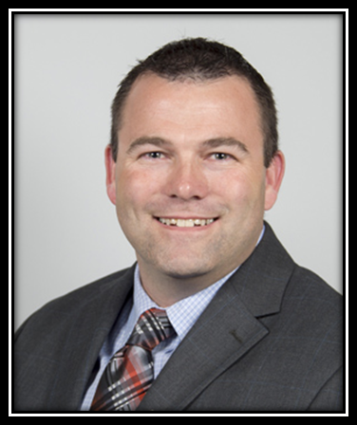
DAV 2021 Legislative Presentation
Stephen “Butch” Whitehead
National Commander
Testimony before a joint session of the
House and Senate Veterans’ Affairs Committees
Wednesday, March 3, 2021
10:00 a.m. (EST)

Slide 10
DAV CAN—DAV Commanders Action Network
WWW.DAV.ORG
Select:
Help
Advocate for Legislation
Click here to sign up!

